Slide 1

Chapter 2-1
Fundamentals of Marketing

Slide 2

Assignment
Go to our Webpage and Read Market Share Article
Read and complete the notes for this section

Slide 3
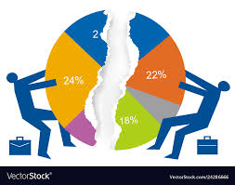
Market share is your share or proportion of sales of a particular product or service in the market.
Calculation:
Business sales / Total market sales

Slide 4
Market Share
Example: If you sell in the Blue Ray players
Total Sales = $4,567,850
Your Sales = $2,985,000
What is your total Market share?
2,985,000/4,567,850 = 65.3%
Notes:
248,000 / 1,500,000 =16.5%
237,000/1,500,000 = 15.8%
32.3-100 = 67.7

Slide 5
Market Share
Example: If you sell in the video game market
Total Sales = 1,500,000
Your Sales = 248,000
What is your total Market share?
248,000/1,500,000= 16.5%
Notes:
248,000 / 1,500,000 =16.5%
237,000/1,500,000 = 15.8%
32.3-100 = 67.7

Slide 6

Brand penetration is the degree to which a product is recognized and bought in a particular market.
market leaders the company with the largest % of revenue (or market share)
market challengers the companies attempting to obtain the largest market share
market followers don't compete because they are happy to just follow the trends established by the leader and challengers.
market niche, not concerned with accumulating large market share but rather decides to operate in a small segment of a market. - gain a strong market share of a special piece of the general market.

Slide 7
Market Share
Example: If you sell in the video game market
Total Sales in this industry are = $1,500,000
If “Competitor X” has sales of 375,000 what is its market share?
Competitor Y has $675,000
You Have $248,000
What percentage of the market is with all your OTHER competitors?
Are you in a good position?
Unclear because you don’t know all the competition!
Market Classification
375,000/1,500,000= 25%
Challenger
675,000/1,500,000= 45%
Leader
248,000/1,500,000= 16.5%
Follower
Other is many companies with small % - a bunch of nichers
100 – (16.5 +25+45) = 13.5%
Notes:
248,000 / 1,500,000 =16.5%
237,000/1,500,000 = 15.8%
32.3-100 = 67.7

Slide 8
Market Share
Market share changes continually as:
New competitors enter the market
The market’s volume increases or decreases
Is it important to know your market share? Why?
Indicates your company strength -Helps you analyze your competitors and their position in the market.
Shows Brand Penetration is good
Increased Brand Loyalty
Notes:
248,000 / 1,500,000 =16.5%
237,000/1,500,000 = 15.8%
32.3-100 = 67.7

Slide 9
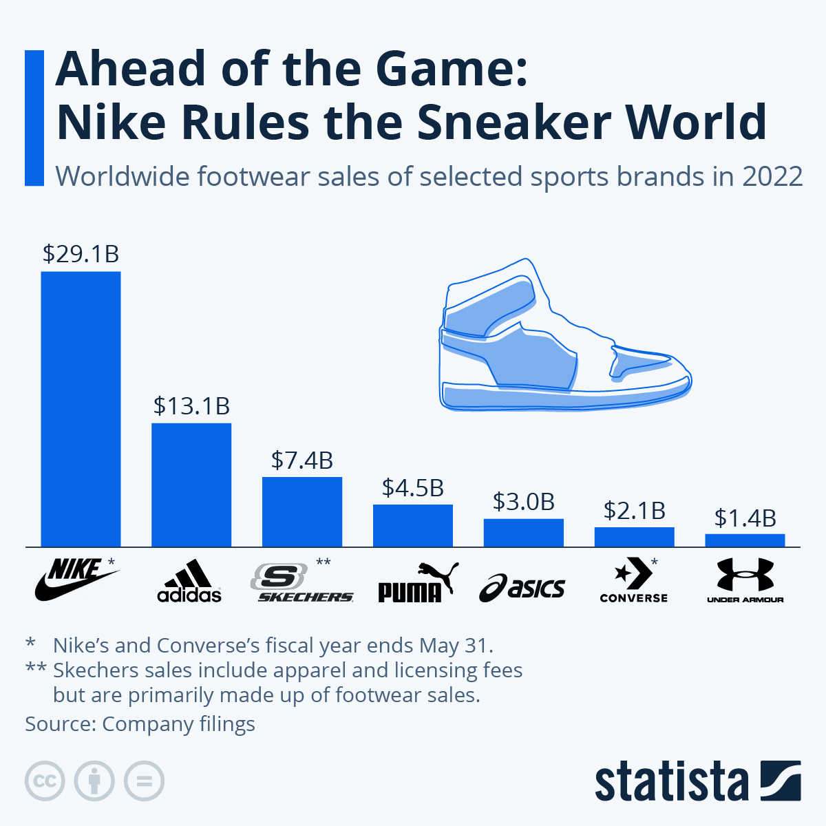
Athletic Shoe Market
Is there a Market Leader?
Challenger?
Any Followers you think?

Slide 10
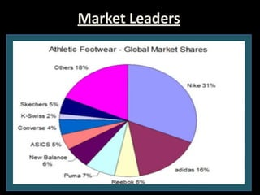
Athletic Shoe Market
In this Graph it shows
Nike 31%
Other 18%
Adidas 16%
What does Other Mean?
Other is many different brands and companies that are grouped together as their Market share is so small. They are Niche markets. They CANNOT BE THE MARKET CHALLENGER!!!
Others 18%
Nike 31%
Adidas 16%

Slide 11
Assignment
Market Share Quiz on Google Classroom.

